Slide 1
ICU Survival rate Mini project 1
By
Miruna Sureshkumar J

Slide 2
Problem Statement
Health care industries has developed higher interest on these machine learning technologies for the sake of accurate diagnosis.
This project involves in predicting patient survival based on the data collected from the first 24 hours of the intensive care unit.

Slide 3
Workflow
Load Data
Split training and test set
Perform EDA
Perform Feature engineering
Build Model
Test
Calculate accuracy.

Slide 4
Dataset
MIT's GOSSIS community initiative, with privacy certification from the Harvard Privacy Lab, has provided a dataset of more than 130,000 hospital Intensive Care Unit (ICU) visits from patients, spanning a one-year timeframe.
It is available in Kaggle.
186 Features
90,000 rows for training.

Slide 5
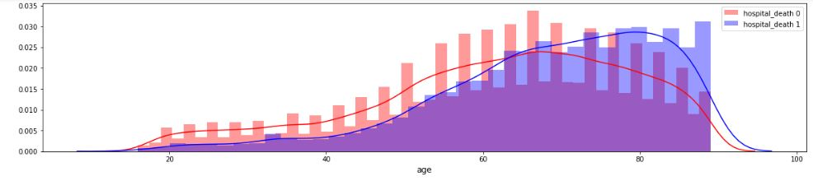
EDA

Slide 6
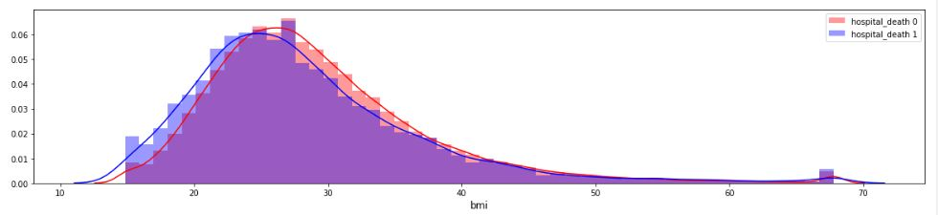

Slide 7
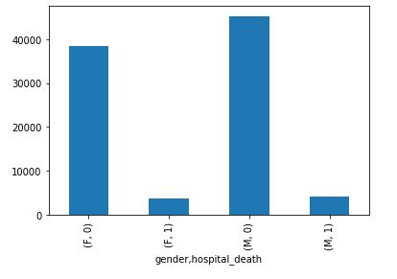

Slide 8
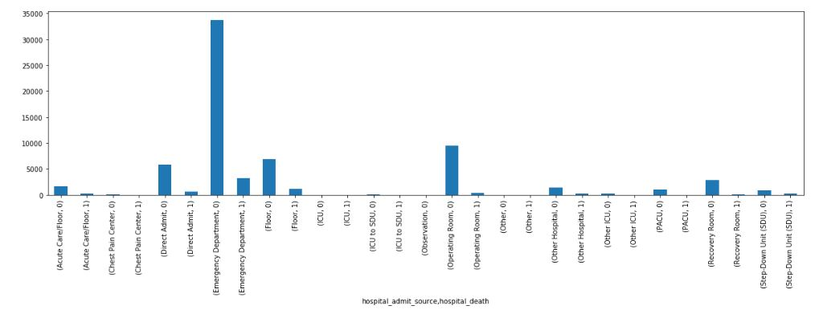

Slide 9
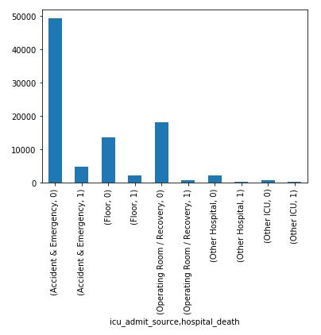

Slide 10
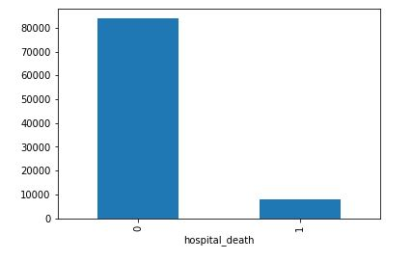

Slide 11
Models comparison
Model | Accuracy
MLP Classifier | 92.57%
Random Forest Classifier | 92.54%
Logistic Regression | 92.5%
Decision Tree Classifier | 88.2%
Gaussian Naïve Bayes | 83.02%

Slide 12

Thanks You!

